Slide 1
INFO3111: C++ Graphics
Day 12
Texturing (part 2) : Cube maps, etc.
Other interesting things you can do with textures

Slide 2
Cube mapping
Lots of uses
Skyboxes, reflection, refraction, light-probes, etc.
Is a set of 6 2D images arranged in a cube
Hence the name
Often the normals, not the UV, of the model is used to do the look up.
In any case, the lookup uses 3 coordinates, not 2 (as with 2D texture mapping)

Slide 3
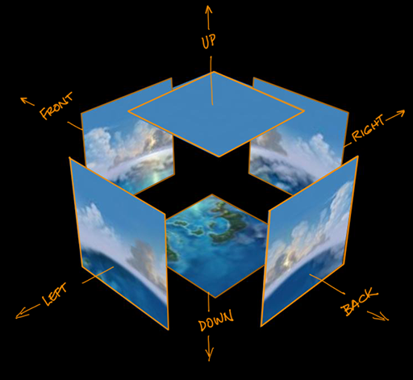
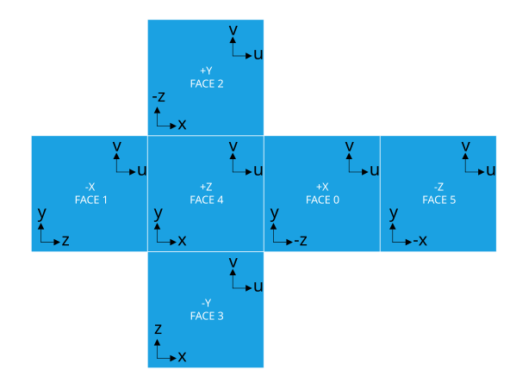
Cube mapping
The 6 textures are mapped to the “sides” of the cube.

Slide 4
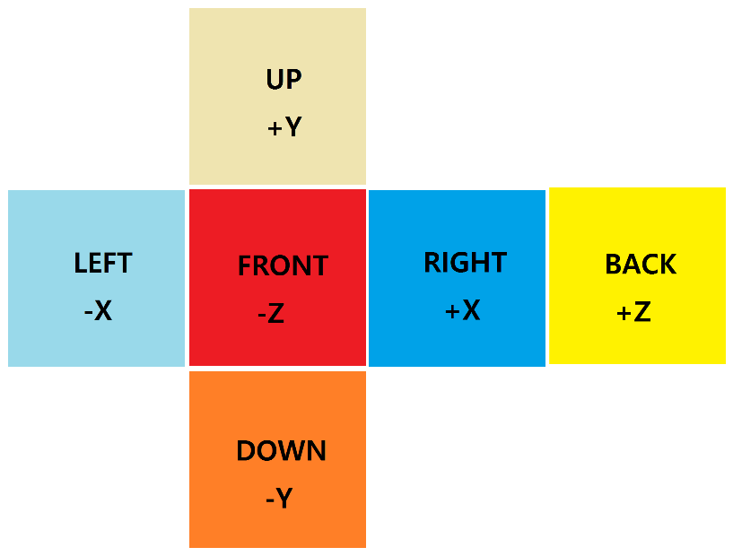
Cube mapping
In OpenGL, there are a set of constants to indicate which side you’re referring to:
GL_TEXTURE_CUBE_MAP_POSITIVE_X
GL_TEXTURE_CUBE_MAP_NEGATIVE_X
GL_TEXTURE_CUBE_MAP_POSITIVE_Y
GL_TEXTURE_CUBE_MAP_NEGATIVE_Y
GL_TEXTURE_CUBE_MAP_POSITIVE_Z
GL_TEXTURE_CUBE_MAP_NEGATIVE_Z
All these together represent a single cube map.

Slide 5
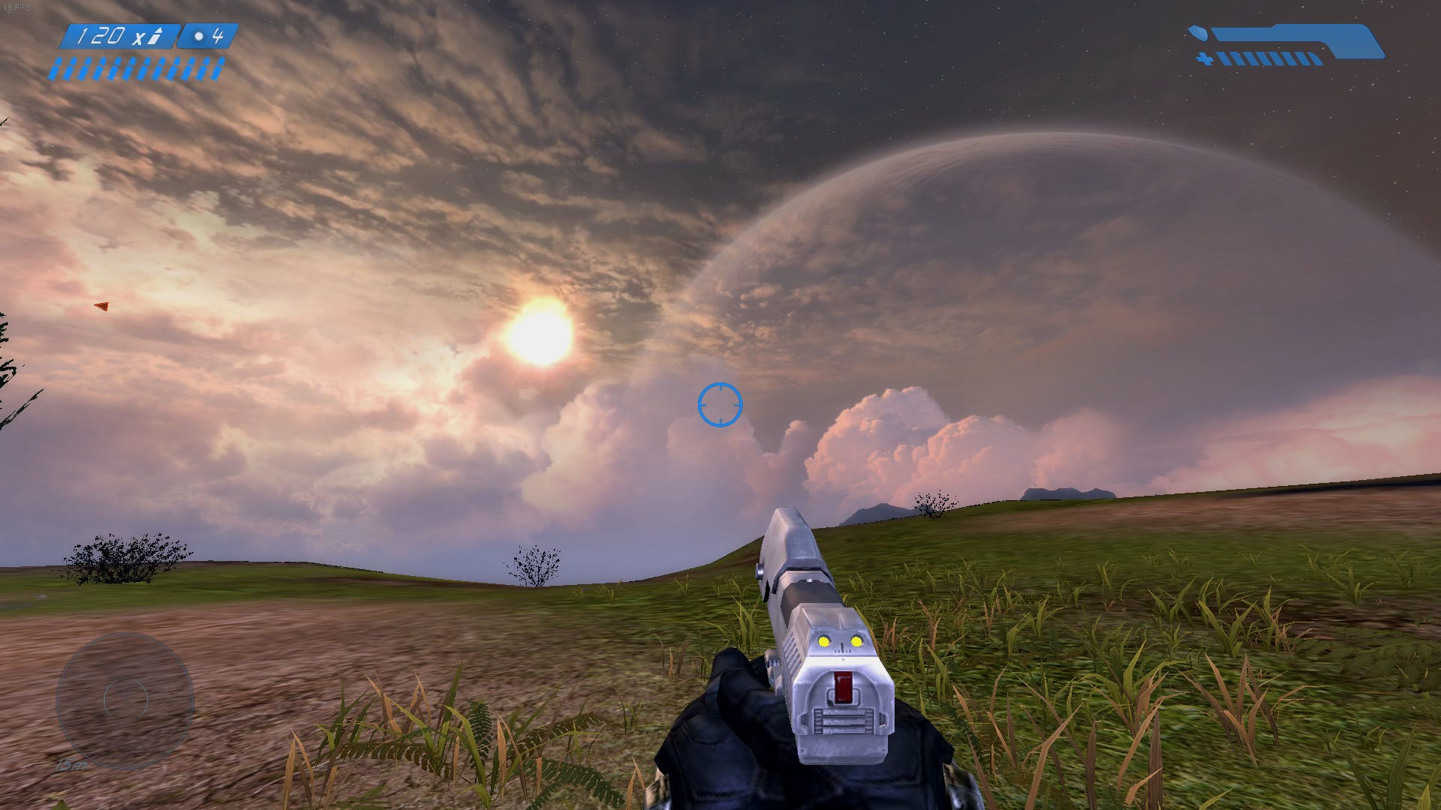
Cube mapping for skyboxes
For very distant objects like the sky, or the horizon that’s far, far away, we can “fake” this by drawing a cube map that surrounds the camera.

Slide 6
Cube mapping for skyboxes
While there are a few variations in technique, the basic idea is that you lookup colours in a cube map that is centred at the camera.
This is often a sphere or ellipse shaped object kept at the location of the camera at all times.
Think: You are “inside” this sphere, which is “painted” with the skybox/cube map texture

Slide 7
Cube mapping for skyboxes
Option #1:
Use a large sphere, large enough to contain the entire scene.
Be careful to set your far plane farther than this sphere.
Move the sphere with the camera (or move everything in the world and keep the camera at 0,0,0…)
This avoids us “worrying” about the depth buffer.
Because the skybox fills the entire screen, you can decide when to draw this based on what else is in the scene.
Large outdoor scene that’s mostly sky: draw the cube map first
Inside where you only see the sky through a window: draw cube map last
But TBH, don’t worry about it.

Slide 8
Cube mapping for skyboxes
Option #2: Drawing a shape that’s 1.0 unit in size either using an actual shape or procedurally generating the shape in the shader:
Turn off the z-buffer (both the depth test and update)
Set the near and far planes very near the camera (the shape is only 1.0 unit in size, after all)
Draw the skybox shape
Turn on the z-buffer again
Update the project matrix (near & far plane) to “normal” for your scene and draw everything the way you did before
We are not doing it this way, but that’s often how it’s done.

Slide 9
Loading the cube map
Done like a 2D texture, but instead:
You bind the texture as a GL_TEXTURE_CUBE_MAP (vs. GL_TEXTURE_2D)
You load all 6 texture “sides” just like you did with the 2D textures, but copy them up with GL_TEXTURE_CUBE_MAP_POSITIVE_X, GL_TEXTURE_CUBE_MAP_NEGATIVE_X, etc. constants
You also want to enable the GL_TEXTURE_CUBE_MAP_SEAMLESS option to hide the transitions between the 6 sides.

Slide 10
Cube maps on the shader
In the shader, you use a samplerCube rather than a sampler2D
uniform samplerCube texSampSkyBoxCube;
The “sample” (lookup of the colour) is almost the same, but we pass 3 coordinates rather than just a UV.
vec4 vRGBA = texture( textSampler2D, vertUVs.st );
vec4 vRGBA = texture(texSampSkyBoxCube, vertNormal.xyz );
We are passing a 3D ray that intersects the cube map.

Slide 11
Cube maps bindings, etc.
The binding on the C/C++ side is just like with 2D textures:
GLuint skyboxTextureID = ::g_pTextureManager->getTextureIDFromName("skyboxTexture");
// Texture binding...
GLuint texture00Unit = 0; // Texture unit go from 0 to 31 (or higher?**)
glActiveTexture( texture00Unit + GL_TEXTURE0 ); // GL_TEXTURE0 = 33984
glBindTexture(GL_TEXTURE_CUBE_MAP, skyboxTextureID );
GLint texSampID = glGetUniformLocation( shadProgramID, “texSampSkyBoxCube" );
glUniform1i( texSampID, texture00Unit );
Note: NOT GL_TEXTURE_2D
(**You can call glGetIntegerv() with GL_MAX_TEXTURE_IMAGE_UNITS) or GL_MAX_COMBINED_TEXTURE_IMAGE_UNITS to find this out.)

Slide 12
Reflection/Refraction
You can also use the cube map to implement reflection and refraction.
Reflection with things like chrome/mirrors/glass/water, etc.
Refraction with transparent things like water/glass, etc.
GLSL has built in functions for this, too!
vec3 reflectedRay = reflect( vec3 incidentRay, vec3 normal)
vec3 refractedRay = refract( vec3 incidentRay, vec3 normal, float reflectionIndex)
This last value in refract is how much the ray bends when transitioning. Google “Indexes of refraction” for a list of values

Slide 13
Reflection/Refraction
You use this by using the reflected and/or refracted ray of the object you want this effect, and look up the cube map, just like you’d do with a skybox.
i.e. you don’t use the normal, but what gets returned by these functions:
vec3 reflectedRay = reflect( vec3 incidentRay, vec3 normal)
vec3 refractedRay = refract( vec3 incidentRay, vec3 normal, float reflectionIndex)
By using a combination of these, you can get some amazing looking images. Note that it’s tricky to get it looking “perfect”…

Slide 14
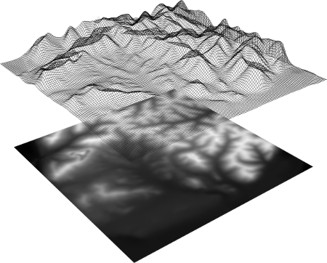
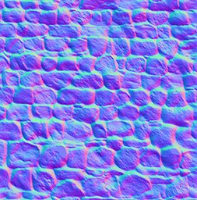
Textures as data
Remember that since textures are really images and images are just data: a 2D texture is literally a 2D array of pixel data…
…you can use this for things you might not expect:
A colour lookup
Changing the displacement (i.e. location) of the vertices in a model
Like in a “height” or “displacement” maps
Or damage, etc.
Adjusting the normal values at each pixel:
“bump” or “normal” mapping
Or really any data: animation, collision info, etc.

